Slide 1
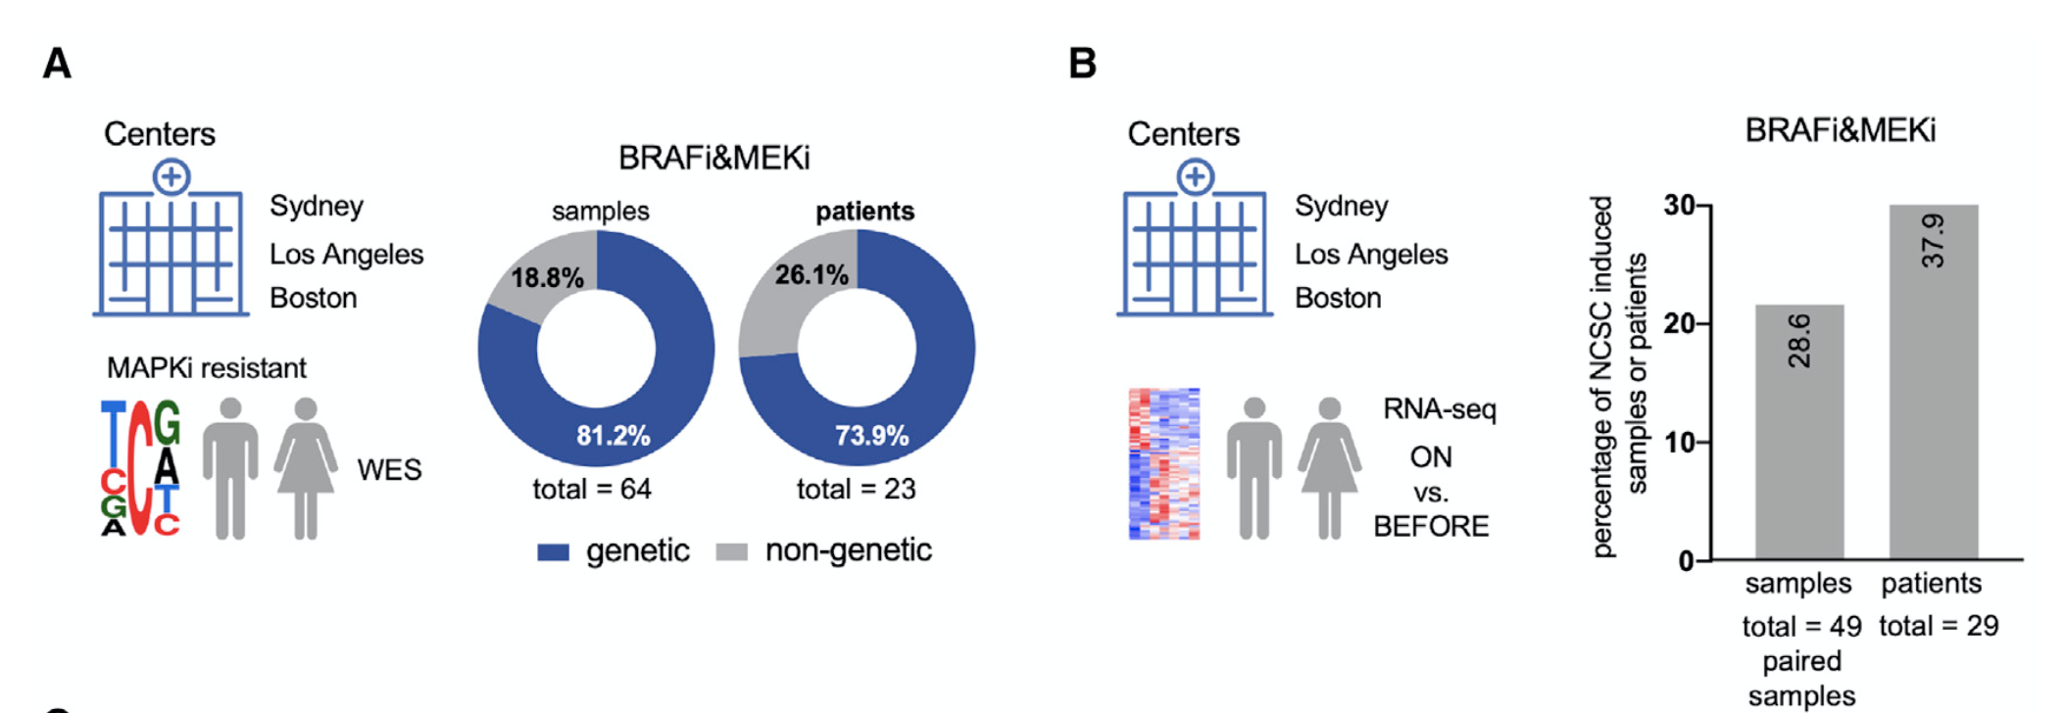
Sydney: linked to 2 publications → PMID: 24463458
→ PMID: 25452114
we have received the following data file from Helen Rizos containing many clinical data and patient keys (see attached):
IlluminaMicroarray_PatientSummaryData_deidentified.xls
- our analysis was based on their “Resistance mechanism detail” column, we received gene expression (can be shared) but never DNA-seq data
- in the microarry_key tab of the .xls file you can see that some patient samples were neither pulished in CCR nor in Nat. Com.
I am not sure if these samples were published meanwhile. That would need some clarification from H. Rizos...

Slide 2
Los Angeles: linked to → PMID: 26359985
Patients/samples with genetic alteration (22 samples, 8 patients)
Patients/samples without genetic alteration (17 samples, 13 patients)
based on their Figure 1A.
Clinical data can be found in their Table S1 (too big to send by Email)
I am not sure they ever released their entire WES data?
Maybe here: PMID: 24265155
Corresponding gene expression data is available on GEO: GSE65185
always baseline levels per patient and ON treatment

Slide 3
Boston: linked to → PMID: 25705882
the clinical data is in the key_tab of “10jan2018_marine_rpkm_targeted_deidentified.xls” , see attached
Boston
A=pretreatment
B=on treatment
C=progression
Gene expression data can be shared:
“Bolande_MGH_RSEM, BRAFi only, for anyone.txt”
too big to send by Email.

